Slide 1

Beyond open source: a technology assessment of open standards and validation tools in the era of Cloud computing and a SaaS case study
Panagiotis Stathopoulos, Nikos Houssos, Prodomos Tsiavos, George Stavrou
{pstath;nhoussos}@ekt.gr
National Documentation Centre / National Hellenic Research Foundation,
http:// www.ekt.gr
Athens, Greece

Slide 2
Agenda
The National Documentation project
Open Source and Grey Literature
Technology Trends and the Cloud
  The Software as a Service Cloud Model
  Issues/Problems and Challenges
Open Standards
Validation Tools
Conclusions

Slide 3
The National Documentation Centre (EKT)
The national organisation in Greece:
  for scientific documentation, online information and support services on research, science and technology
  Objective: making knowledge accessible to everyone
Incorporated in National Hellenic Research Foundation (NHRF)
Implements the “National Information System for Research and Technology”: http://epset.gr
  CRIS systems, Digital Repositories, e-Publishing, Digital Libraries, Interactive Culture, and more…
  Open Access advocate: http://openaccess.gr, OPENAIRE/OPENAIRE+ member and NOAD.
  Greek National Aggregator: http://openarchives.gr
  Repository as a Service (SaaS) and validation services: http://www.epset.gr/en/SaaS_Services

Slide 4
Grey Literature and Open Source
Open Source: a critical component of our community’s technological infrastructure
Open Source empowered organisations to easily implement:
  Digital Repositories and Digital Libraries
  Infrastructures with reduced cost and increased local “know-how”
  Reduced initial setup cost
  Provided solutions & tools to the public, the grey literature professionals and organisations

Slide 5
Open Source Assessment
Open source has being a disruptive force but:
  look beyond the initial purchase and installation cost
Indicative IT systems lifecycle:
  Datacenter/computer room infrastructure,
  Hardware initial purchase cost, depreciation, maintenance and support
  Initial design, development, customisation
  Software maintenance and support, bug fixes, security fixes, new features requested
  System administrators, Monitor and Control Loop
Thus Open Source is only a part of a full infrastructure solution
  Is it possible for every organisation to maintain technological capabilities to support the whole application lifecycle efficiently?

Slide 6
Technology Trends: from Open Source to the Cloud
Cloud technologies:
  A variety of technology service offerings, with different definitions but with common core elements:
    Self service
    Networked
    Common pool of resources
  Service Models:
    Infrastructure as a Service
    Platform as a Service
    Software as a Service
  Central to EUs Digital Agenda 2020
  Significant economies of scale

Slide 7
The Software as a Service Model
Software as a Service (SaaS)
  Complete solution can fully outsource a system
    Hardware / Middleware/ software development and maintenance
    Monitor and Control, Operations, and Management
  Can resemble hosted services but usually with a increased degree of customisation
  SaaS applications examples:
    docs.google.com, Microsoft Live, Adobe Connect, etc.
A promise for cost reduction (?)
  And focus to each organisations core competencies

Slide 8
Grey Literature and the Cloud
IaaS and PaaS Service Models:
  Provide new horizontal capabilities (especially PaaS, big data etc)
  However largely transparent
Software as a Service Model:
  Usually Vertical. Systems that could be available as SaaS:
    Digital Repositories
    Current Research Information Systems
    Integrated Library Systems
    Digital Preservation
    Repository interoperability
    Aggregation Services (as centralised services)
  Full blown solution

Slide 9
New Issues
So are our troubles end with the Cloud?
  Some of them
  Others, more interesting ones, appear:
Issues:
  From s/w vendor lock-in to Cloud vendor lock-in?
    Prepare migration strategy to different systems in order to avoid “cloud lock-in”
  Are our data exportable and migration capable?
    Ensure data are “exportable” and export formats are standards-based
    Ensure interoperability APIs
  Plus additional issues: is an open source based SaaS based also on proprietary elements and techniques? Security? Cloud Provider long term viability? SLAs monitoring/enforcement?

Slide 10
Grey Literature and Open Standards
Open Standards provides the communication tools for interfacing different systems, different content using a common “language”
Structure content:
  Flat (DublinCore) or rich (CERIF, EDM, etc)
  Initial cost of implementation but reduced long term cost and increasing viability
Independent from Software, Implementation method and Service Model
  Increasingly critical factor to a number of additional applications/services

Slide 11
Open Standards
We know the significance of open standards for interoperability/aggregation/etc
Additionally standards, and standard format increasingly critical for:
  Migrating our data among SaaS providers
  Avoid SaaS provider lock-in
    Create a “SaaS” market
  Avoiding closed not interworking systems

Slide 12
A Repository as a Service case study
EKT is Developing a “Repository as a Service” SaaS for eligible Greek organisations:
    provide Digital Repositories as a Service, for scientific publications, grey literature, cultural institutions and archives
    Build on EKT’s experience for developing and operating repositories for third parties
  http://epset.gr/en/saas/ :
    First pilots (semi automated) ready.
    Next goal: further automation of tasks
  Open standards and validation tools in order to increase third party organisations trust

Slide 13
The need for guidelines
Metadata and functionality validation tools are critical for:
  Repository as a Service development
  Digital content interoperability
  Aggregation mechanisms
EKT has specified basic interoperability guidelines for digital repositories:
  http://hdl.handle.net/10442/8887
    English translation under way
  Applicable both if development by EKT, provided as SaaS or developed externally
Ensures a minimum level of interoperability independent of
  Software
  Implementation method
  Delivery method (in house, outsourced, or Cloud)

Slide 14
Mandates
Could combine guidelines, funder’s mandates and funding in order to guarantee high quality projects/outcomes
Case study:
  The Greek Digital Convergence Funding authority mandated that digital repositories must implement Digital Content Interoperability guidelines
    Call mandated: http://www.digitalplan.gov.gr/portal/resource/Prosklhsh-31-Politismos
    >75 funded organisations, 65Μ€ of funding.
    Focused on digital culture but includes Grey Literature related content

Slide 15
The need for validation tools
Automatic validation of guidelines critical
  Link automatic validation to value added services
  E.g.: aggregator harvesting (OpenAIRE+, EUROPEANA) to funder mandate (Digital Convergence/EKT)
Various validation tools for various standards:
  Free, open, or project specific
  E.g. http://oaipmh.ekt.gr , http://www.openaire.eu:8380/dnet-validator-openaire/, Europeana Content Checker, etc.
    (also CERIF validation tool under development)
Multi-level Validation of repositories
  Cultural, archival, etc
  Generic and specific cases

Slide 16
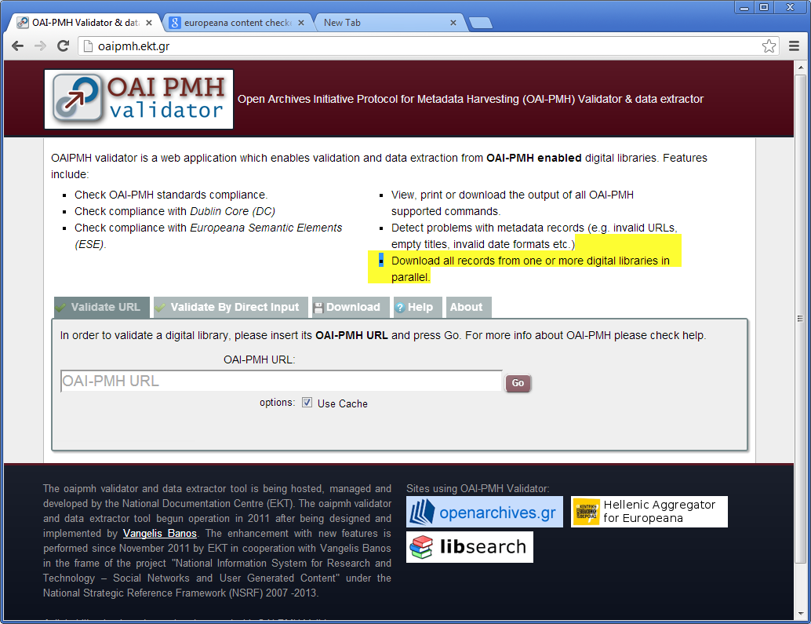
Validator Example (1)

Slide 17
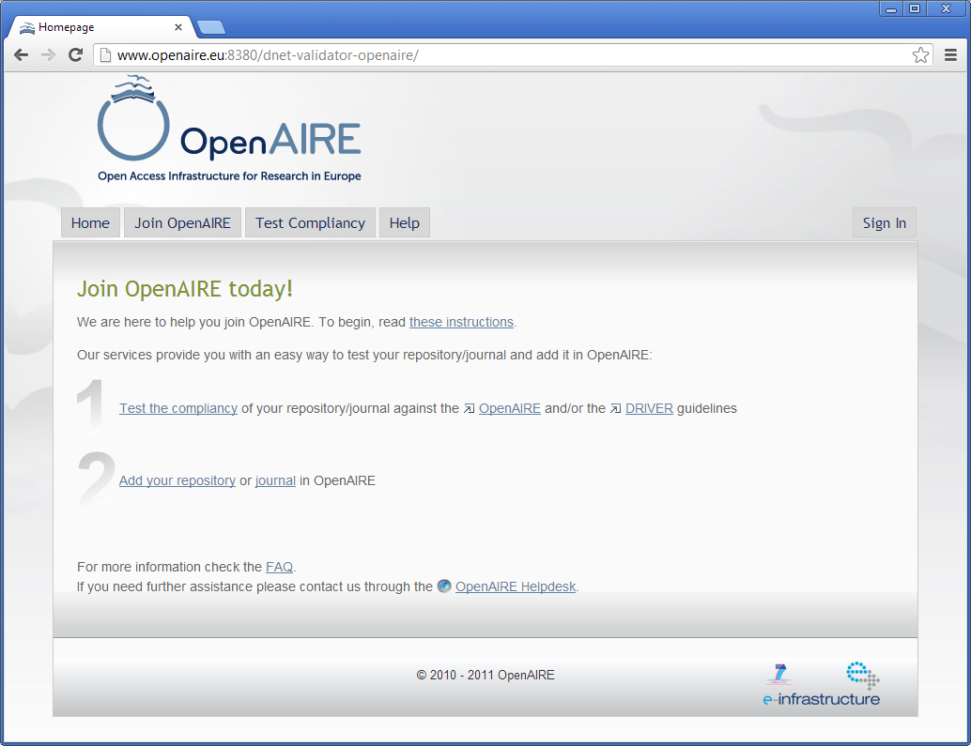
Validator Example (2)

Slide 18
Validation Benefits
  Ensure wide interoperability and aggregation
  Avoid “data” lock-in, ensure capability to transfer content and service among:
    Different Digital Library/Repository software
    Different SaaS cloud providers
      Exploit advantages of Cloud without “lock-in” dangers
  Ensure high quality of funded Digital Repositories and Libraries
  Continuous implementation of the chosen guidelines

Slide 19
Conclusions
Open Source was (and is) a key driving factor for Digital Libraries
We must expand the interoperability and flexibility capabilities Open Source has provided
  While exploiting where applicable Cloud and SaaS resources
How?
  Open Standards for content
  Interoperability specifications and guidelines
  Automatic validations tools
  Aggregation Services

Slide 20
Thank you for your attention!
pstath@ekt.gr
nhoussos@ekt.gr

