Slide 1





The Data Model of the OpenAIRE Scientific Communication e-Infrastructure
Paolo Manghi¹, Nikos Houssos^{2,4}, Marko Mikulicic¹, Brigitte Jörg^{3,4}
¹ISTI - Consiglio Nazionale delle Ricerche, Italy
²National Documentation Centre / National Hellenic Research Foundation, Greece
³Innovation Support Center, UKOLN, University of Bath, UK
⁴ euroCRIS

Slide 2
Agenda
Introduction / background
The OpenAIREplus information space and data modelling requirements
Reuse of known data models
  CERIF
  DataCite
The OpenAIREplus data model
Modelling use cases within OpenAIREplus
Summary – conclusions

Slide 3
Metadata in scholarly communication systems
Metadata in scholarly communication systems: describes mainly publications typically using variants of Dublin Core, MARC or MODS.
Flat metadata structures with limited facilities (e.g. links to authority files) to represent relationships among entities
For example, linking publication and organisation (e.g. in roles publisher, author affiliation, commisioner)

Slide 4
Emerging metadata needs
Two emerging requirements ask for more sophisticated metadata solutions:
  Metadata needs to describe also data sets (heterogeneous, more complex than publications)
  Contextual metadata is highly important – need for relationships of publications and data sets with projects, funding programmes, organisations, etc. to provide more sophisticated services to the end user
OpenAIRE (2nd phase) needs to address both these challenges!
Approach: Reuse existing data modelling approaches and standards
  CERIF
  DataCite

Slide 5
The OpenAIRE e-infrastructure
1st phase (in operation since 2010): a central point of access to OA publications funded by the EU FP7 projects in a range of thematic areas
2nd phase (OpenAIREplus project)
  include metadata describing data sets and their semantic links to publications
  incorporate research output produced all over Europe through any type of funding (not restricted to EU FP) including linking of outputs and projects with funding programmes
Substantial upgrade of the data model required to address these challenges

Slide 6
The OpenAIREplus information space
Includes entities such as publications, datasets, projects, licenses, persons, data sources, organizations, funding programmes.
Captures semantics relationships among entities
Data collection from various data source types:
  Publication repositories
  Data repositories
  CRIS systems
  Entity registries (e.g. ORCID, CORDA, OpenDOAR)

Slide 7
OpenAIREplus services
Services to end-users
  Researchers
  Data source managers
  Project coordinators
  Funding agencies
Services to applications
  APIs
  Data retrieval in standard data formats (CERIF XML, DataCite)

Slide 8
Reusing known data models
CERIF
  Common European Research Information Format
DataCite

Slide 9
CERIF
Conceptual model, mostly used in the research domain
  Maintained by euroCRIS - used by 100s of institutional and national systems in Europe and beyond
  Other application domains exist in the industry and the public sector
Clear separation of syntax and semantics
Explicit definition of the semantic of relationships among entities
Temporal aspects of relationships captured
Many data properties represented as semantic relationships – not rigid data fields
Inherent support for multi-linguality (field values in different languages)

Slide 10
CERIF Semantic Layer
Links/relationships among entities and classifications of entities
Roles, timestamping (date range), fractions
Definition of terms, vocabularies and relationships among them
Examples:
  OrgUnit X merged with OrgUnit Y in April 2011
  Person X was Project Manager of Project Y from January 2010 to April 2011
Facilitates role-typed, timestamped links to entities in other systems (e.g. identifier systems, registries, authority files)

Slide 11
CERIF Semantic Layer example
role=author1-institute
role=editor
role=... ?
role=author
role=author1
role=reviewer
role=... ?
role=deliverable1.2
role=journal article
role=public report
role=CEO
role=researcher
role=project-manager
role=funder
role=investigator
role=member
role=coordinator
role=manager

Slide 12
CERIF in OpenAIRE
CERIF has been adopted in OpenAIRE (second phase) to represent contextual metadata about publications and datasets
CERIF Semantic Layer used to represent relationships with defined semantics
Ability to dynamically inject into the system vocabularies and terms without altering the data model structure
Ability to represent arbitrary funding structures and their connections with publications and data sets

Slide 13
DataCite
International consortium
Aims at making data citable in a harmonized, interoperable and persistent way
DOIs must be assigned to datasets
Standard DataCite metadata format
  Mandatory properties: title, authors, publishing year, distributor, persistent identifier
  Optional properties, including links to other datasets and publications
Used by many data repositories (e.g. PANGAEA, DANS)

Slide 14
DataCite in OpenAIRE
DataCite will be the standard metadata used by data repository data sources to contribute content to OpenAIRE
DataCite data elements have been embedded to the OpenAIRE data model
OpenAIRE will be able to export dataset metadata as DataCite metadata records
OpenAIRE plans to exchange with DataCite the following types of data
  Dataset metadata
  Dataset-dataset and dataset-publication relationships

Slide 15
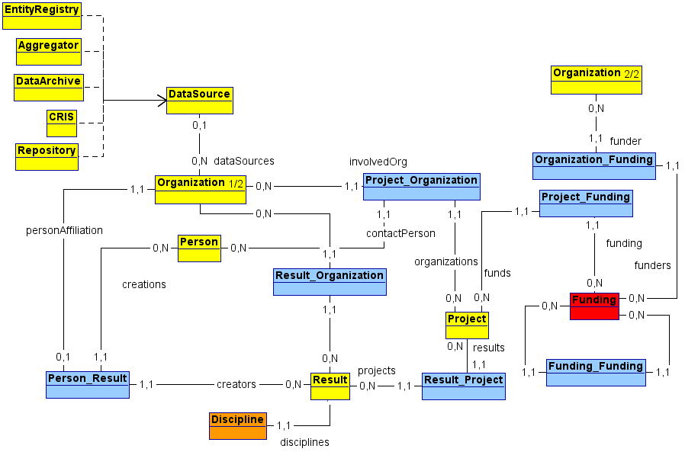
The OpenAIREplus data model

Slide 16
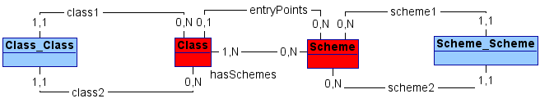
Semantic layer entities
CERIF Semantic Layer applied for capturing the semantics of relationships and classifications of entities
Ability to represent vocabularies (Scheme) and terms (Class)

Slide 17
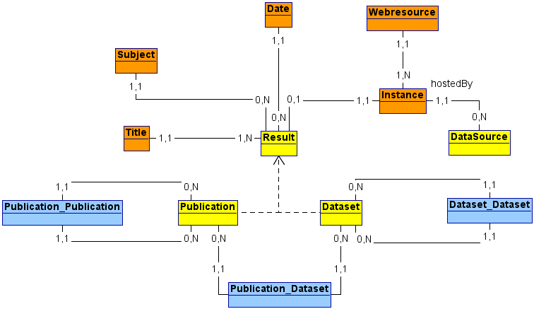
Result entities

Slide 18
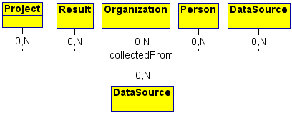
Data sources – provenance relationships
A link to the originating data source is maintained for all entity instances collected and inserted into OpenAIRE

Slide 19
Modelling use cases in OpenAIREplus
Representing multiple different funding structures (e.g. fron EU and national programmes) simultaneously – EU FP7

Slide 20
Modelling use cases in OpenAIREplus
Representing multiple different funding structures (e.g. fron EU and national programmes) simultaneously – a Greek national funding programme

Slide 21
Modelling use cases in OpenAIREplus
Linking projects to funding

Slide 22
Summary – future work
The OpenAIREplus data model has been described – the core of the OpenAIRE e-infrastructure.
Designed to address modelling of the increasingly complex scientific communications environment
Constantly evolving research environment requires flexibility and adaptability
Advanced functions and services in development – facilitating data curation, coping with data interference

Slide 23
Thank you for your attention!
More info:
paolo.manghi AT isti.cnr.it
nhoussos AT ekt.gr
marko.mikulicic AT isti.cnr.it
brigitte.joerg@gmail.com

