Slide 1
Implementing a funder repository with heterogeneous material and advanced presentation capabilities
Ioanna-Ourania Stathopoulou, Nikos Houssos, Panagiotis Stathopoulos, Despina Hardouveli, Alexandra Roubani,
Alexandros Soumplis, Chrysostomos Nanakos
National Documentation Centre / National Hellenic Research Foundation, Greece

Slide 2
Agenda
Aims and scope of the project
Methodology and approach
Implementation / DSpace extensions
Conclusions – future work

Slide 3
Project context
Hellenic Ministry of Education programmes for education and lifelong learning, co-funded by the EU structural funds
Three phases: 1994-1999, 2000-2006, 2007-2013
Overall funds in the range of billion Euros
Activities funded:
Face-to-face courses / seminars
Creation of educational material
Studies, surveys, reports
Conferences, workshops
Research: theses, collaborative projects

Slide 4
Aims and scope of the project
Decision by funding authority to create a repository (autumn 2010)
Aims: Dissemination, reuse and preservation of the digital material produced in the frame of the funded programmes
Single point of (persistent) access to material, standards-based documentation/metadata, interoperability, link of content to project / funding programme
Repository available (since spring 2011)
http://repository.edulll.gr

Slide 5
Project inputs and outputs
Input material:
Digital files arranged in folders – (hopefully) according to project
List of projects
No metadata!
Output aimed for:
Repository with standards compliant metadata records along with processed digital files, suitable for dissemination
User-friendly interface for human users
Programmatic interface (OAI-PMH) for reuse by third-party software applications

Slide 6
Methodology and approach
Investigate input material
Identify content of archival value – exclude all other material (e.g. administrative documents)
Assign priorities to content
Documentation / cataloguing of material according to standards – application profile created
Subject cataloguing
No self-archiving at this phase
Digital processing of input files to produce copies suitable for preservation and dissemination – both initial and processed files kept in repository
A lot of effort allocated to user-friendly interfaces for browsing metadata and accessing content

Slide 7
Metadata schema
Custom application profile developed based on common international schemata
Qualified Dublin Core
LOM
PREMIS
CERIF
Vocabularies used
Eurovoc for thematic indexing – due to inter-disciplinarity and multi-linguality
Eurydice vocabulary for education levels

Slide 8
Metadata schema
Custom application profile developed based on common international schemata
Qualified Dublin Core
LOM
PREMIS
CERIF
Vocabularies used
Eurovoc for thematic indexing – due to inter-disciplinarity and multi-linguality
Eurydice vocabulary for education levels

Slide 9
Processing workflow
Create metadata record.
Upload initial digital files to repository.
Handle assigned to record.
Metadata record published. Digital files not visible.
Digital file processing
instructions
Digital file processing
(format transformations, merging/splitting, OCR, file rename)
Publication of processed digital files

Slide 10
DSpace extensions
Submission form enhancements
User-friendly browsing (tagcloud, image-based type browsing)
Embedding of video files
Online reading / streaming of text material

Slide 11
Submission form enhancements
Simplify procedure, fewer steps
Enter metadata and upload multiple files from single form
Subsequently edit metadata from submission form
Multi-lingual controlled vocabularies with user-friendly values
Various new widgets (e.g. language selection for fields, name processing)

Slide 12
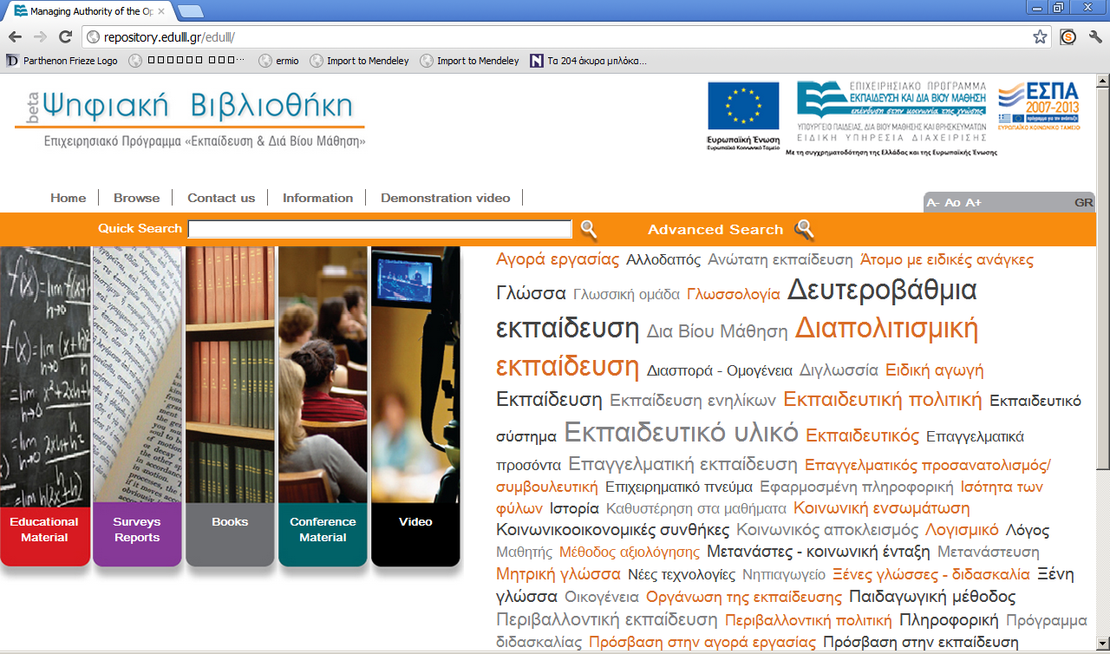

Slide 14
User-friendly browsing
Tag cloud for subjects
Configurable from dspace.dfg – can be used for any other field indexed for browsing
Image-based browsing for content types

Slide 15
Configurable tag cloud (examples)
# Select the browse index to create a tag cloud for in the home page # Possible values: any of the browse indices webui.tagcloud.home.bindex = subject # # Select the total tags to show # Possible values: any integer from 1 to infinity webui.tagcloud.home.maxtags = 50 # # Should display the score next to each tag? # Possible values: true | false webui.tagcloud.home.showscore = false # # The score that tags with lower than that will not appear in the rag cloud # Possible values: any integer from 1 to infinity webui.tagcloud.home.cutlevel = 5

Slide 16
Embedding video files
H.264 enconding using a F4V video file container
Video stream provided by Woowza
Flowplayer selected from embedding video on metadata record page on repository
Video-related fields included to the metadata submission/edit form

Slide 17
Online reader for text
No need to download big files
Bookmarking/sharing at the page level
User access statistics at the page level
Compatible with multitouch interfaces / tablets
Based on the Internet Archive Book Reader
Pages are JPEG2000 files served by an image server
Sophisticated infrastructure for back-end processing

Slide 18
Online reader backend
Two-tier backend:
content delivery and
content transformation
Content delivery:
Nginx/Varnish load balancer/caching to 2 node tomcat/djatoka cluster serving JPEG2000 over a shared SAN storage and utilising a 3 node Postgres 9 cluster
Content transformation
“Shadow” backend with specialized multithreaded content types transformation server
After transformation content copied to the delivery backend
Interfaced to OJS/Dspace
Manages the automatic batch conversion of content
Available as OSS (jp2k-distiller) http://code.google.com/p/jp2k-distiller/

Slide 19
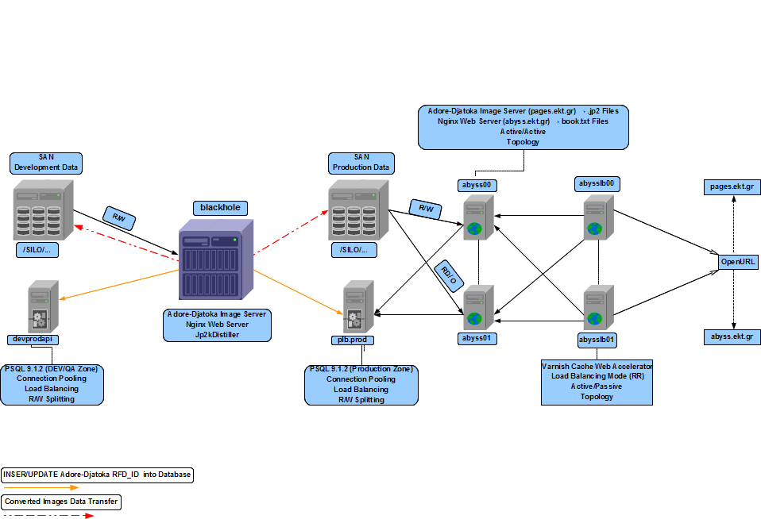

Slide 20
Jp2k-distiller & dpool – features
Available as OSS (http://code.google.com/p/dpool/)
Set of python scripts that schedules and manages batch conversion of content files to different formats, exploiting multithreaded batch conversion features.
Need to run multiple encoders/per server in order to achieve high sustainable conversion ratesortunity window lasts until the batch ends.
Three (3) different conversion options over various Queues
PDF/TIFF → PNG Conversion Queue
PNG → JP2000 Conversion Queue
JP2000 → Publishing Queue
Interfaced with OJS and DSpace over a HTTP interface
New version: dpool (so radically improved we had to change names! ☺)
Tool for modular batch handling of any type of content conversion
Truly multinode: a central dispatcher server and an artibitaty amount of distributed “slave” workers over multiple physical or virtual servers
Technologies: Python, ZeroMQ – for master-slave node communication, GlusterFS as common filestore, MongoDB for statistics, NodeJS – for web based dashboard
You can start with one conversion machine and scale to hundreds

Slide 21
Future work
Support self-archiving (two phase cataloguing)
Include CRIS functionality – through a separate CERIF based system
Various new features for presentation of content

Slide 22
Thank you for your attention!
More info:
iostath@ekt.gr
nhoussos AT ekt.gr
pstath@ekt.gr

