Slide 1
Advances in Technology and CRIS
Nikos Houssos
National Documentation Centre / National Hellenic Research Foundation, Greece
euroCRIS Task Group Leader Projects

Slide 2
Agenda
Introduction
Indicative overview of a selection of technologies in CRIS systems
Impact of technology evolution on CRIS

Slide 3
Technologies
Semantic web technologies/ Linked Data
Cloud computing / Software as a Service
Tools to present content
Mobile devices – context awareness
Software engineering / application frameworks – interfaces with databases
Data processing technologies

Slide 4
Semantic web technologies
Vision: machine processable content and links, “intelligent agents”
RDF / OWL
Identifying resources with URIs and linking between them
Inference capabilities
Not widely used
Extremely high degree of expresiveness
But cannot easily express everything, e.g. temporal information in relationships

Slide 5
Semantic web in practice
Significant advances have been achieved
Many challenges still to tackle
Performance / scalability issues
A range of tools is available
Tools to generate / process / edit RDF, OWL
Triplestores, unified servers
Considerably lower degree of tools and platforms maturity compared with their counterparts for relational database back-ends

Slide 6
Linked Open Data
A method of publishing structured data in a way that facilitates linking / interconnection of information.
Identify entities / resources with URIs that can be dereferenced and resolve to useful information in RDF.
In the description of resources include links to other resources.
Identifying resources with URIs and linking between them.
Very useful to support information interconnection, navigation and other services.
Specialised euroCRIS Task Group formed in 2011 to standardise how LOD can be produced from CERIF databases.
Relevant projects: VOA3R, ENGAGE

Slide 7
Cloud Computing
Computing as a utility
Infrastructure as a Service (IaaS)
Provision of virtual machines, storage, network
Platform as a Service (PaaS)
Provision of a computing platform and a full stack to develop and run applications.
Software as a Service
Turn-key operation of application software in the cloud, minimal or no need for IT expertise by the client

Slide 8
Software as a Service and CRIS
Minimal or no need for IT expertise by organisations to run the system, very good fit for small-to-medium size institutions (and not only)
Multi-tenant architecture
A single instance serves many clients
Substantial gains in efficiency, utilisation
Facilitates updates / upgrades
Considerable effort to develop applications that support multi-tenancy
Associate records in the database with tenant identifiers
High degree of paremeterisation capabilities required by application to allow transparent customisation on a per tenant basis.
Need to address security, access control, monitoring/billing
Need to interoperate with systems that might run locally at the institution.
Can be used as a model for running institutional CRIS in a single infrastructure at the regional or national level.

Slide 9
Tools and technologies to present content
Visualisation
Online readers / browsers for digital material
Specialised tools for datasets

Slide 10
Visualisation
Many open source tools and free online systems available
Based on standard, open, widely supported technologies (e.g. non-Flash)
Dynamic generation of practically all types of common graphs
More sophisticated visualisations (e.g. network diagrams, tree maps, timelines)
Maps / geospatial information visualisation
High degree of interactivity

Slide 11
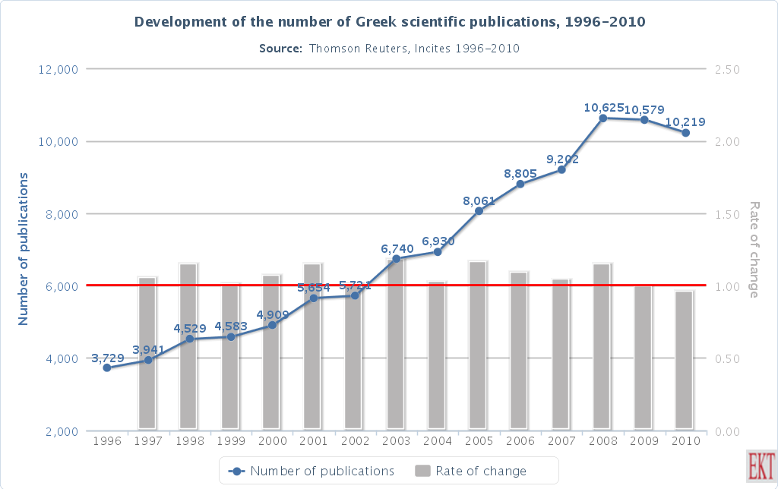
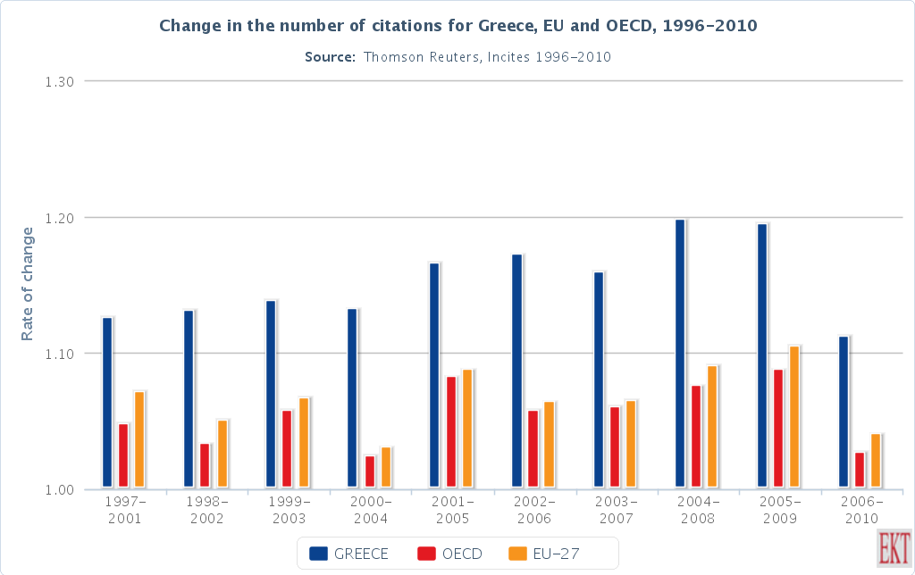
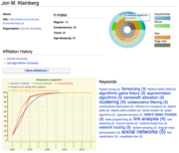
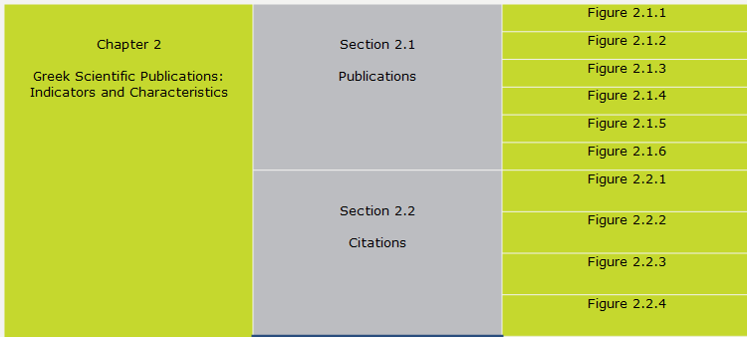
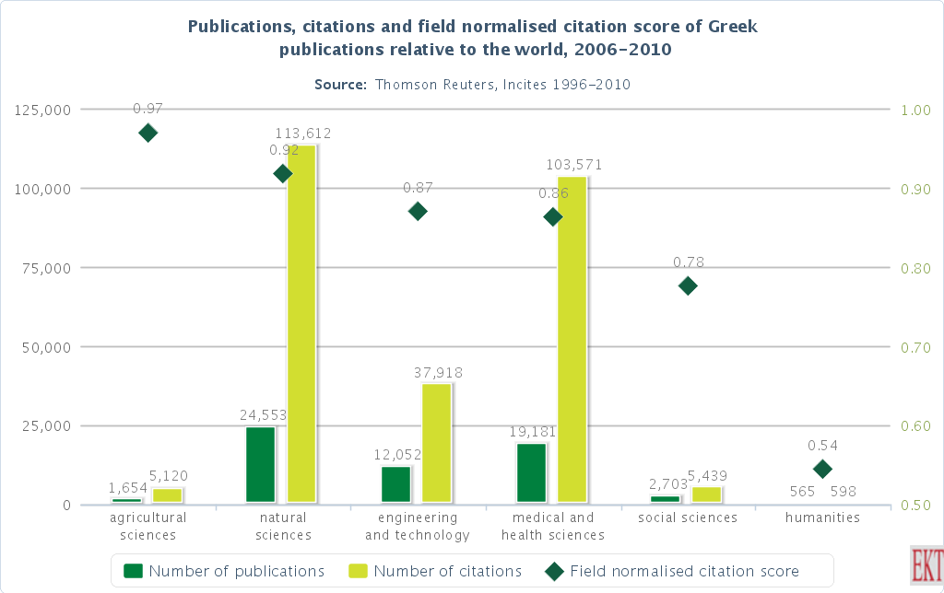
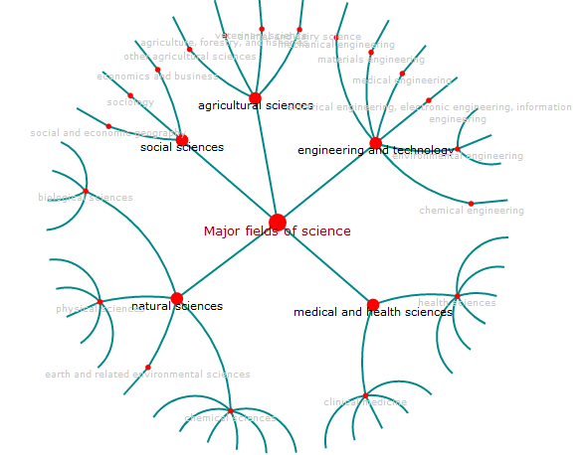

Slide 12
Online readers / browsers for digital material
Significant capabilities not available with off-line reading / browsing:
Bookmarking and sharing at the page level
Annotations at the page level – available anywhere
Detailed access statistics – navigation / bookmarking information
Better promotion of the overall system - back links to CRIS
Progressive, incremental streaming of content – very useful for files of large sizes.
Many tools available based on standard, open, widely supported technologies (e.g. non-Flash)
Many specialised tools for domain-specific material and datasets

Slide 13
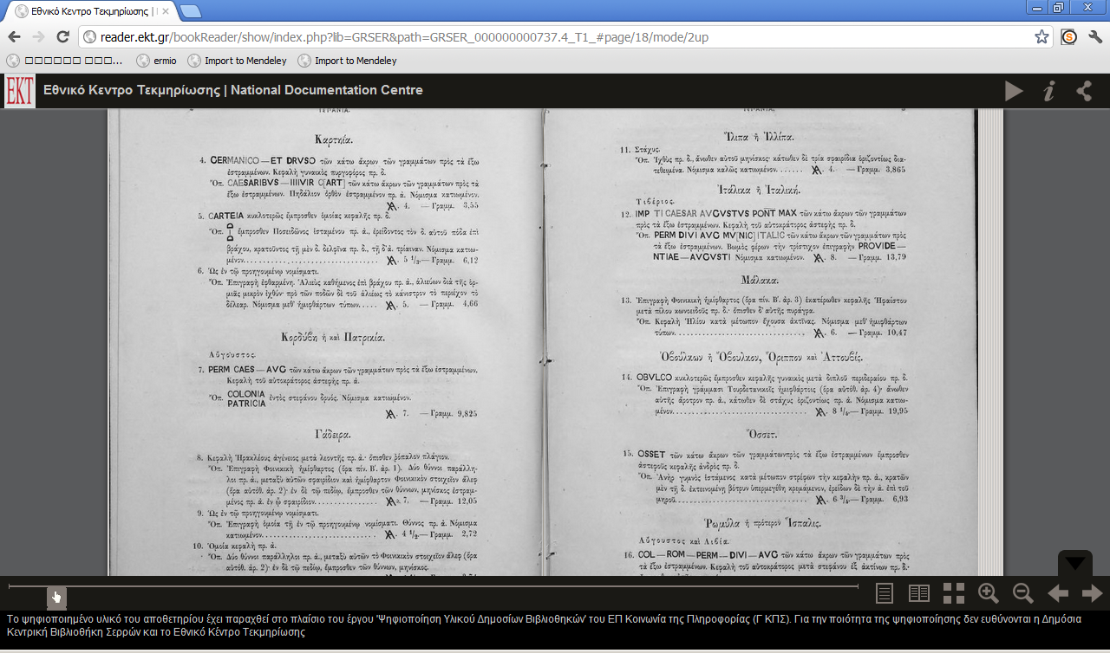

Slide 14
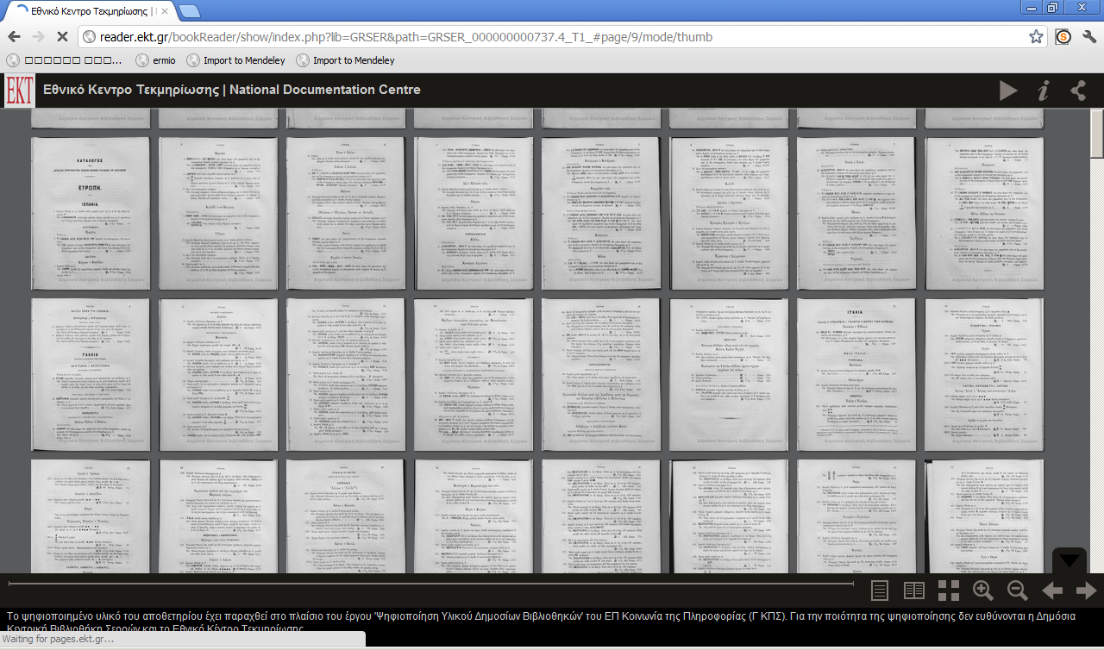

Slide 15
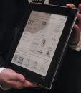
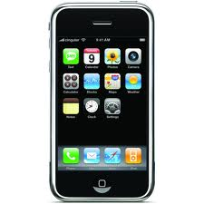
Mobile devices / context-awareness

Slide 16
Mobile devices / context-awareness
Does it make sense for CRIS?
The answer is definitely Yes!
Anywhere access to research information
Particularly useful when combined with visualisation / online reading-browsing capabilities
Personalisation and context awareness can be really important
Considerable cost for application developers
Portability to different device characteristics (e.g. size, screen resolution, execution environment)
Native application execution environments may (still) offer better experience, but the implementation cost is high
Making applications context-aware might be quite complex

Slide 17
Application frameworks - interfaces to databases
Application frameworks and interfaces to databases
Object-to-relational mapping tools
Automatic generation of source code to interface with the database
Dynamic generation / execution of code on-the-fly
Ready components for common tasks (e.g. user management, authentication, web services, etc.)
Easy to build simple applications from the database specification
In practice, significant additional effort is required to achieve high performance, scalability, appropriate user interfaces, customisability
Dependency on a stack of complex tools that can be buggy

Slide 18
Data processing
Automating tasks for data quality and interoperabilty
Automatic data cleaning, entity identification, schema mapping
Many techniques (e.g. machine learning, statistical)
Great advances in research in the last decade, further automation is very challenging
Automatic metadata extraction / citation parsing
Machine learning techniques (e.g. based on Conditional Random Fields)
Open source tools available
ParsCit, FreeCite, etc.

Slide 19
Thank you for your attention!

